Slide 1
American Rescue Plan Act (ARPA) Overview For The City of Watertown, MA
Presented to the Committee of the Budget and Fiscal Oversight
By: City Manager George J. Proakis
February 1, 2023

Slide 2
American Rescue Plan Act Overview
Municipalities across the nation are the beneficiaries of a significant influx of federal funds via the American Rescue Plan Act (ARPA). ARPA is intended to address the negative health and economic impacts caused by the COVID-19 pandemic.
Watertown is expected to receive $10.5 million in ARPA funding that must be encumbered by the end of 2024 and spent by the end of the 2026 calendar year.
As the City continues through the ARPA process, and the three-year period in which to spend this funding, it is important to understand that the ARPA Framework may continue to evolve as we learn more about eligible program areas and community needs.

Slide 3
American Rescue Plan Act Funds
Boston: $569,007,913
Communities with similar funding:
Andover: $10,867,057
Chelmsford: $10,355,385
Lexington: $ 9,903,381
Natick: $10,548,208
Watertown: $10,515,729
Gosnold: $7,399
Communities Near Us:
Arlington: $36,793,673
Belmont: $7,641,526
Cambridge: $87,893,020
Newton: $65,291,040
Waltham: $36,189,436

Slide 4
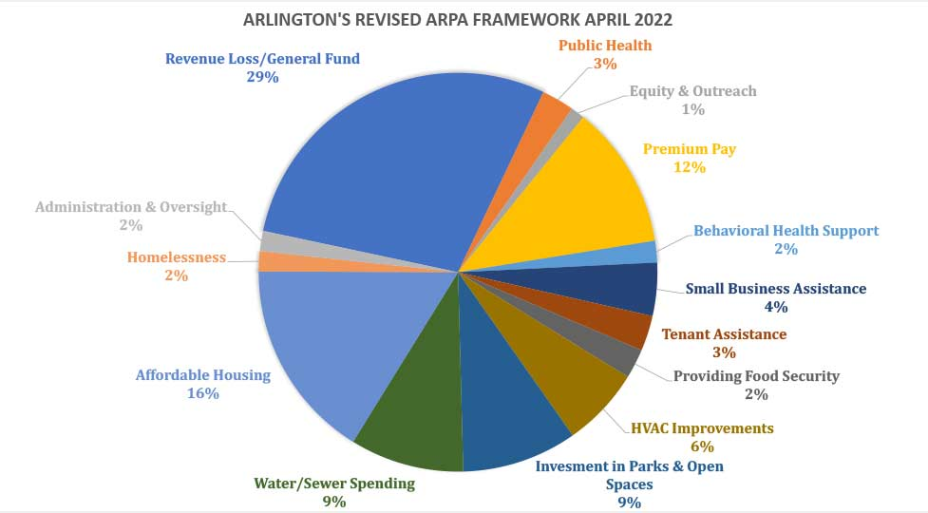
Arlington's Revised ARPA Framework April 2022

Slide 5
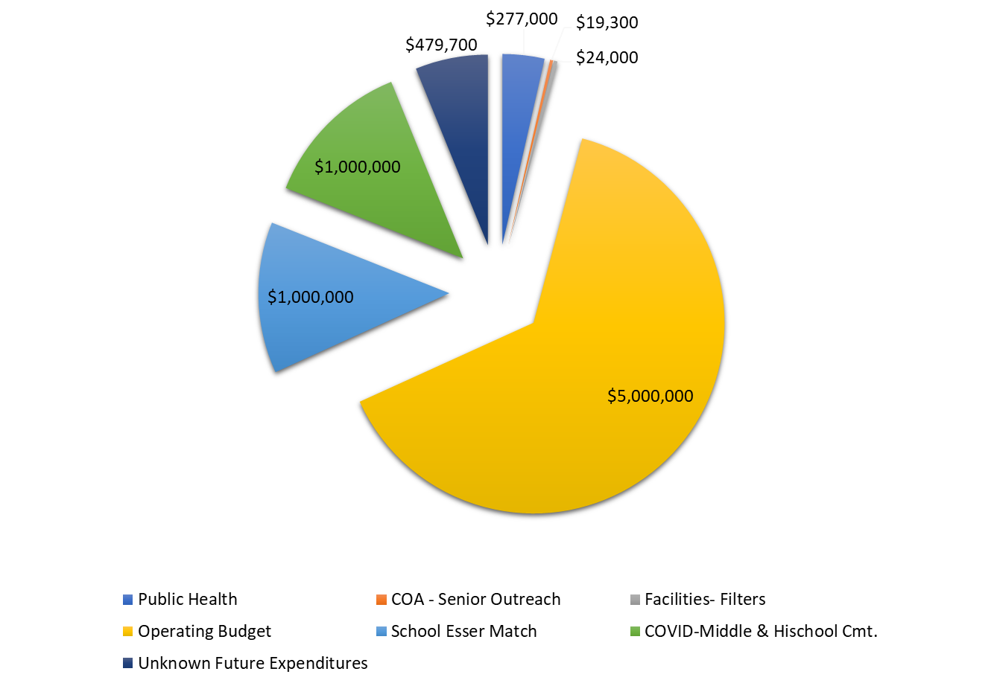
Belmont’s Proposed ARPA Distribution of Funds

Slide 6
Cambridge’s ARPA Funded Projects as of 7/5/2022 Page 1 of 7

Slide 7
Cambridge’s ARPA Funded Projects as of 7/5/2022 Page 2 of 7

Slide 8
Cambridge’s ARPA Funded Projects as of 7/5/2022 Page 3 of 7

Slide 9
Cambridge’s ARPA Funded Projects as of 7/5/2022 Page 4 of 7

Slide 10
Cambridge’s ARPA Funded Projects as of 7/5/2022 Page 5 of 7

Slide 11
Cambridge’s ARPA Funded Projects as of 7/5/2022 Page 6 of 7

Slide 12
Cambridge’s ARPA Funded Projects as of 7/5/2022 Page 7 of 7

Slide 13
Cambridge Highlights
Cash Assistance: $22 million
Non-profit Relief Fund: $6 million
Transitional Wellness Center: $5.6 million
Restaurant and Nightlife fund: $2.5 million
Climate Crisis Response (based on task force): $2.5 million

Slide 14
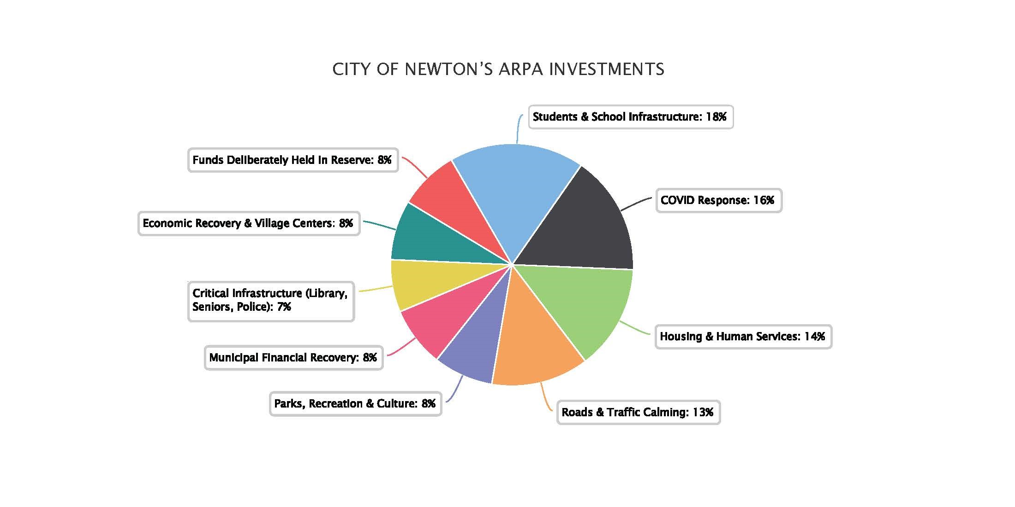
Newton’s ARPA Investments (as of September 15, 2022)

Slide 15
Communities with Similar Funding Andover Page 1 of 4
ARPA Category: Capital Improvements/Infrastructure
Project | Total Budget
Conservation Land Management Policy Development | $9,500
Emergency Management Capacity and Initiatives | $75,000
Ledge Road Landfill | $2,250,000
Old Town Hall Parking Lot Infrastructure | $300,000
Park Property Phased Implementation | $950,000
Town Building Improvements | $1,510,000
Water Main Transmission Lines | $2,800,000
Water Treatment Plant Security Enhancements | $100,000
Total Capital Improvements/Infrastructure | $7,994,500

Slide 16
Communities with Similar Funding Andover Page 2 of 4
ARPA Category: Public Health and Pandemic Response
Project | Total Budget
Behavioral Health Contracted Services/Staffing | $400,000
Board of Health Regulation & Policy Review | $22,500
Expanded Elder Home Visits | $64,385
Pandemic Response | $550,000
Reserve/Contingency | $700,000
Public Health and Pandemic Response | $1,736,885

Slide 17
Communities with Similar Funding Andover Page 3 of 4
ARPA Category: Community Assistance and Partnerships
Project | Total Budget
Expansion of Public Cable Access | $20,000
Rental and Home Buying Assistance | $200,000
Small Business Assistance - Economic Development | $300,000
Community Assistance and Partnerships | $520,000

Slide 18
Communities with Similar Funding Andover Page 4 of 4
ARPA Category: Community Engagement & Administration
Project | Total Budget
Administration and Oversight | $255,672
General Allocation for CARES/FEMA Non-Reimbursed | $60,000
Participatory/Community Driven Programs | $300,000
Community Engagement & Administration | $615,672
Total: | $10,867,057

Slide 19
Communities with Similar Funding Chelmsford
More information forthcoming
Projects approved and considered include substantial HVAC and indoor air quality improvements to buildings

Slide 20
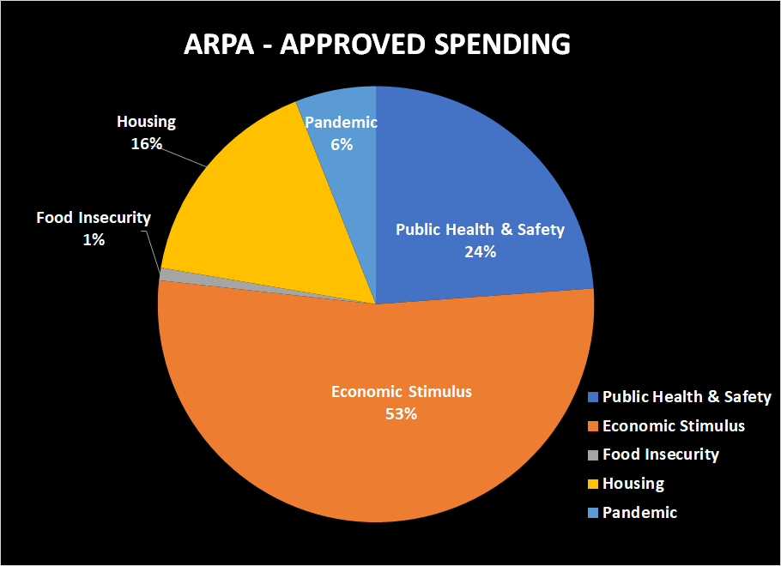
Communities with Similar Funding Lexington
As of December 5, 2022, the Select Board has approved for use $5,418,229 of Lexington’s $9.9 million in ARPA funds. Additionally, $1,100,000 of the Town's ARPA funds are set aside for Participatory Budgeting and food insecurity. The current balance of the Town's ARPA funds is $3,385,152.

Slide 21
Communities with Similar Funding Natick

Slide 22
Strategies to Approach ARPA
Wat programs were most impacted by COVID?
How do expenditures meet city goals and budget priorities?
How can we use funds to provide the most lasting impact?
How can we make sure expenditures are sustainable?
How do we avoid a funding "cliff" in 2026?
How do we ensure that all funds are spent by 12/31/2026?

Slide 23
ARPA Topics of Interest
Infrastructure:
Water/Sewer
High School Cost Overruns
Affordability:
Improvements to affordable housing
New affordable housing development
Housing assistance payments to individuals and families
Climate Impacts
Planting of additional trees / rain gardens / etc.
Additional investments in climate infrastructure

Slide 24
ARPA Topics of Interest
Business Impacts:
Small business direct assistance
Small business marketing programs
Municipal Workforce:
Payments to individual staff that worked through COVID-19
Ramp up staffing in key areas:
Grant writer
Small business assistance
Others
Other:
General grants to community organization for COVID impacts, recovery, resiliency

Slide 25
QUESTIONS

